Slide 1
Rh isoimmunization
Dr. Tiran Dias MBBS
Senior Lecturer and consultant in Obstetrics and Gynaecology

Slide 2
Scope of this Lecture
Pathophysiology of Isoimmunization
Prevention of Isoimmunization
Prediction of fetal Anemia
Management of Fetal Anemia

Slide 3
Reasons for Fetal Anemia
Red cell isoimmunization
Parvovirus Infection
Feto-maternal haemorrhage
Thalassaemia
Pyruvate kinase deficiency
MCDA twins

Slide 4

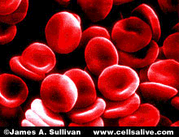

RHESUS ISOIMMUNISATION
Sensitization depends on :
    Volume of FMH
    Magnitude of the mother’s immune response
PLACENTA

Rh-ve
Rh+ve
First
Pregnancy

Slide 5

RHESUS ISOIMMUNISATION
   
   
   
   
PLACENTA
Rh-ve
Rh+ve
Second
Pregnancy

Slide 6

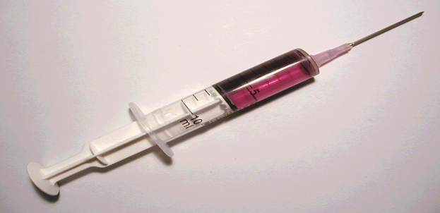
RHESUS PREVENTION

PLACENTA
First
Pregnancy

Slide 7
RHESUS PREVENTION
PREVENTION
ONLY FOR
RHESUS DISEASE
(CDE/cde)
Anti- D available
Red Cell
Isoimmunizations Occur
with Kell, Duffy Ag

Slide 8
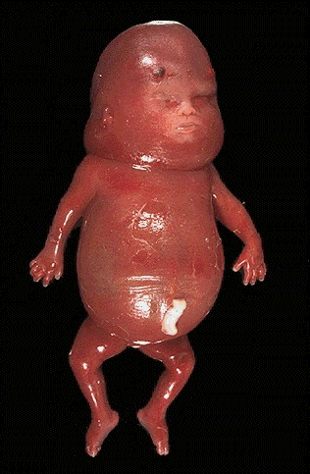
Consequences are common
Fetal Anaemia
is Treatable
Hydrops confers
high MORTALITY

Slide 9
Rhesus (anti-D) prophylaxis
Without Anti D in a Rh negative mother
    1% will have antibodies at the end of 1st pregnancy with a Rh+ fetus
    7-9% will have antibodies by 6 months postpartum
    7-9% after a second pregnancy
    Overall 17% will have antibodies by end of 2nd pregnancy

Slide 10
Monitoring the pregnancy
Check ABO and Rh status at the booking visit
If Rh+ unexpected antibodies will be checked in the T3
If Rh- Antibody screening is done at booking, 28 and 34 weeks
If antibodies are present, Paternal blood phenotype
  If Rh- assume an Rh- fetus, routine follow-up
  If Rh+ determine Paternal Genotype
    If homozygous – fetus will be Rh +
    If heterozygous – 50% baby will be Rh+

Slide 11
Monitoring the pregnancy
If Antibodies are present…
An Anti D <4 IU t the (1:32) Minimal risk of HND
If Antibodies >10IU (1:64) at the beginning of the pregnancy or sudden rise – need further Ix
If father heterozygous – Invasive testing for fetal Rh status or maternal blood for fetal DNA
Serial Antibody levels once a month till 28 weeks, every fortnight thereafter.

Slide 12
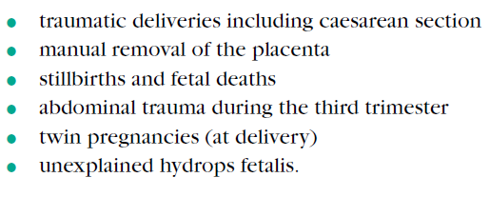
Rhesus D Prophylaxis
Anti-D immunoglobulin (anti-D Ig) began in the UK in 1969
Approximately 99% of women have an FMH of less than 4 ml. (>50% of transfusion >4ml occurs at delivery)
Large FMH is likely to be associated with:
A Kleihauer screening test should be performed within 2 hours of delivery to identify RhD-negative women with a large FMH who require additional anti-D Ig.

Slide 13
How should anti-D Ig be administered?
Anti-D Ig should be given as soon as possible after the potentially sensitising event within 72 hours
Anti-D Ig dose given within 10 days may provide some protection.
When is anti-D Ig prophylaxis required following miscarriage, ectopic pregnancy and termination of pregnancy?
Anti-D Ig 250 iu up to 19+6 weeks and 500 iu thereafter.
A test for the size of FMH should be performed when anti-D Ig is given at or after 20+0 weeks of gestation.

Slide 14
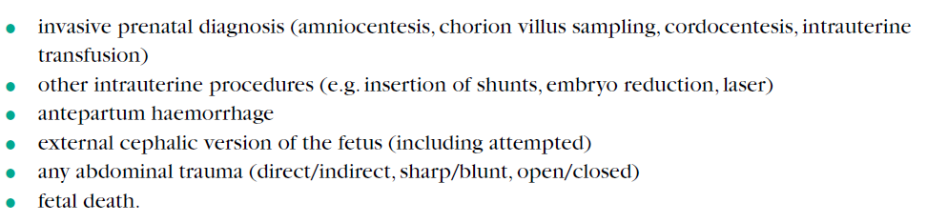
Prophylaxis following sensitizing events before delivery

Slide 15
Routine antenatal prophylaxis (RAADP)
RAADP should be offered to all non-sensitised RhD-negative women

Slide 16
PREDICTION/SCREENING OF ANAEMIA
History & level of Antibodies
Pathological Fetal Heart Rate pattern
Invasive procedures
Ultrasound evidence
Cordocentesis - Diagnostic

Slide 17
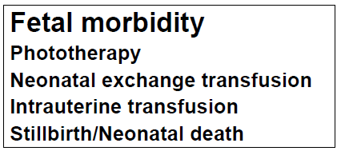
PREDICTION/SCREENING OF ANAEMIA
History & Antibody Titres
Maternal History
Gestation
Fetal morbidity in index case
Previous History
Titres of anti-D
<5 IU/ml (1:32) 3% anaemic
5-14 IU/ml moderate anaemia
>15 iu/ml (1:128) 30% anaemic

Slide 18
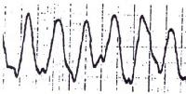
PREDICTION/SCREENING OF ANAEMIA
Pathological Fetal Heart Rate pattern – Sinusoidal

Slide 19
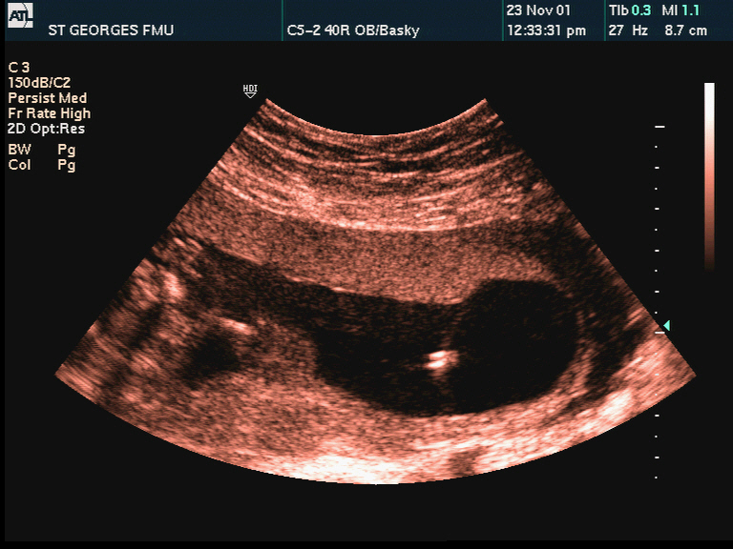
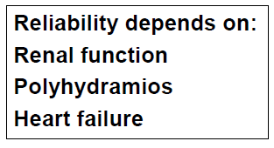
PREDICTION/SCREENING OF ANAEMIA
PREDICTION OF ANAEMIA
Amniocentesis - Spectrophotometry
Liley’s Chart, 1961
Zone 3
OD 450
Zone 2
Zone 1
Weeks Gestation

Slide 20
PREDICTION/SCREENING OF ANAEMIA
Doppler - Blood Flow Velocity
Flow Velocities
Increased in all vessels
Middle Cerebral Artery
Brain responds --Hypoxia
Easy visualization
0-deg Insonation
Good Reproducibility

Slide 21
Doppler - MCA Peak Systolic Velocity

Slide 22
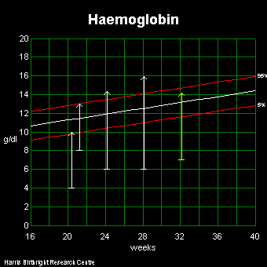
Intrauterine Transfusion
Volume and frequency
Volume of transfusion
10mls per week >20wks
Max 100ml transfusion
Rate = 5-10ml/min
Frequency of transfusion
Hb drop = 2g/dl/week
Hb drop initially faster
Delivery >35weeks

Slide 23
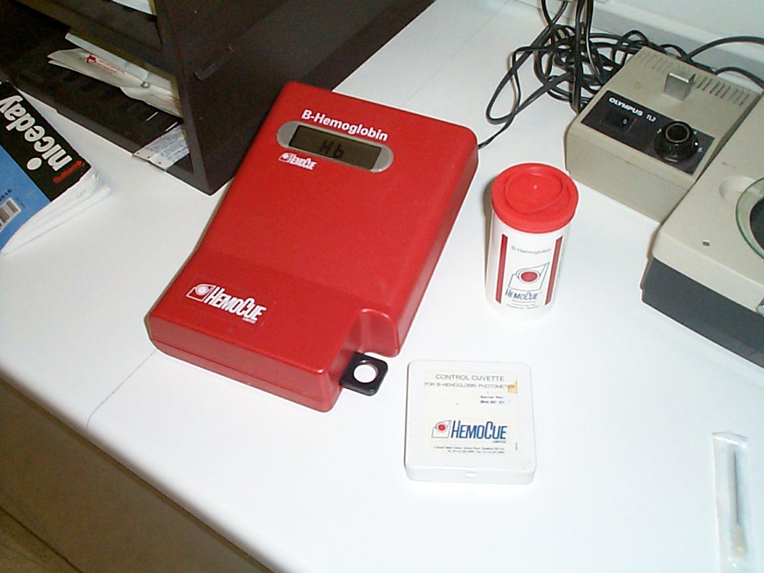
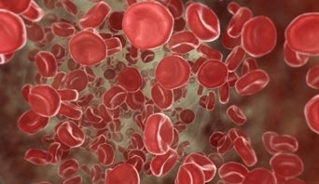
Intrauterine Transfusion
Preparation
Blood
Maternal or donor
Cross-matched
Washed
Resuspended (>24g/dl)
Irradiated
Neonatal cots
Steroid prophylaxis
Hemocue machine

Slide 24
Summary
Rh isoimmunization can be taken place throughout pregnancy
Most common during third stage of labour
Anti D prophylaxis prevents sensitization
Regular follow-up is needed in sensitized mothers to diagnoses fetal anaemia and consequence of fetal anaemia

Slide 25
Thank you

